Slide 1
How Can a Wellness Technology
Company Play It Smart?
Informing Bellabeat's Marketing Strategy for Growth
Timothy Wilson
August 2023

Slide 2
Project Overview and Objectives
Bellabeat's quest to leverage smart device data for growth opportunities in the market.
The marketing analytics team aims to analyze smart device usage data to gain insights into consumer behavior and guide Bellabeat's marketing strategy.
Notes:
The project Overiview is to help make a data driven decision to help bellabeat find growth opportunities in the market. And utilize smart device usage data to gain insights into consumer behavior to guide the marketing strategy for Bellabeat

Slide 3
Purpose of the Data Analysis
1. What are some trends in smart device usage?
2. How could these trends apply to Bellabeat customers?
3. How could these trends help influence Bellabeat marketing strategy?
Notes:
The Purpose of this analysis was to answer 3 main questions,.....

Slide 4
Data Sources Description
Non-Bellabeat smart device usage data will be analyzed.
This data will provide valuable insights into consumer behavior beyond Bellabeat's products.
Notes:
Non Bellabeat smart device usage was analyzed to provide the insights beyond Bellabeat’s products.

Slide 5
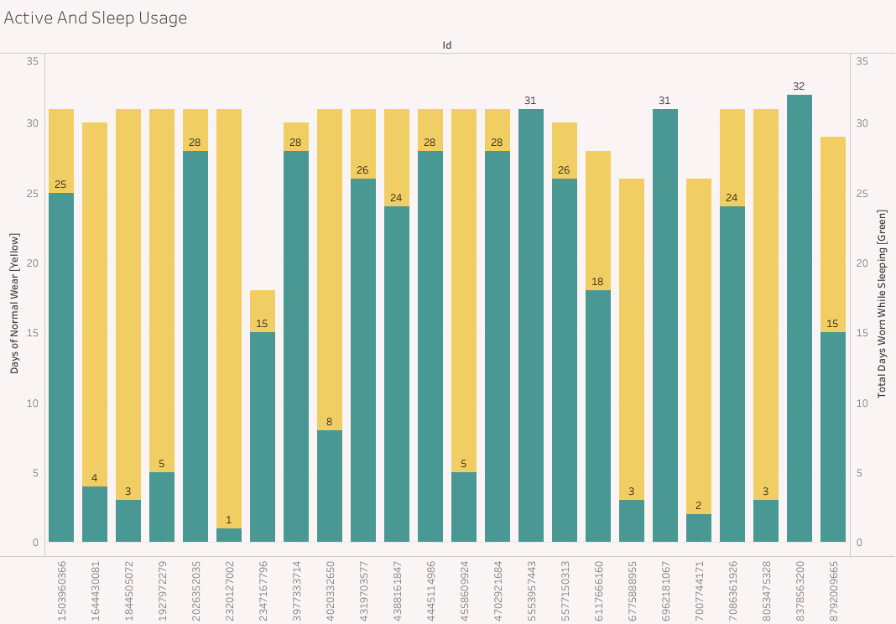
Key Findings #1
Utilzation of Sleep Usage varies greatly from individual to individual.
33 individuals showed normal usage
24 used during sleep cycle ranging from once to consistently.

Slide 6
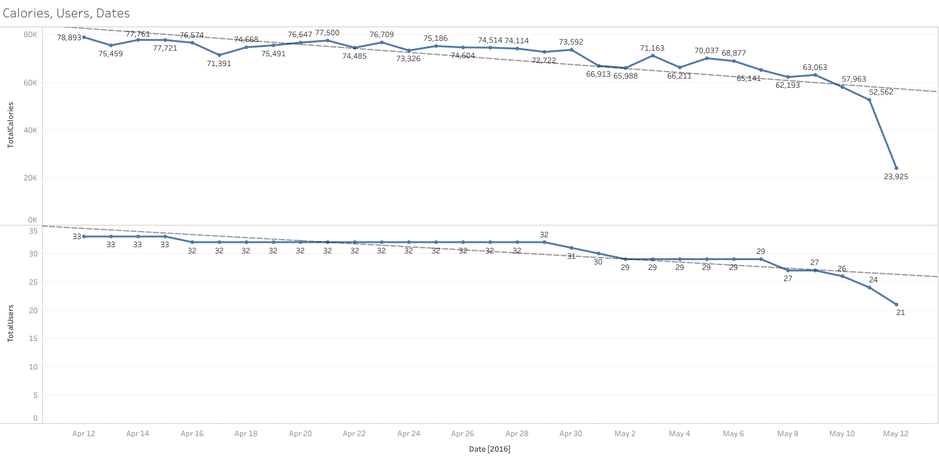
Key Findings #2
Usage started strong with the 33 individuals
Starting at day 25 there was noticeable drop in usage

Slide 7
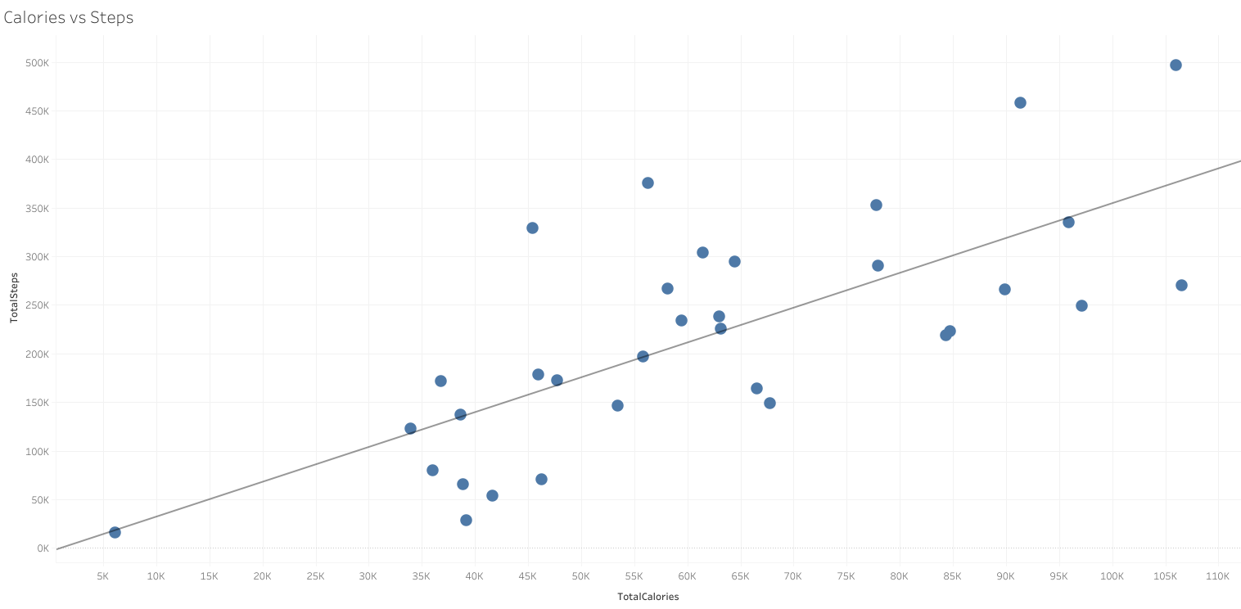
Key Findings #3
Positive correlation was found when comparing steps and calories burnt

Slide 8
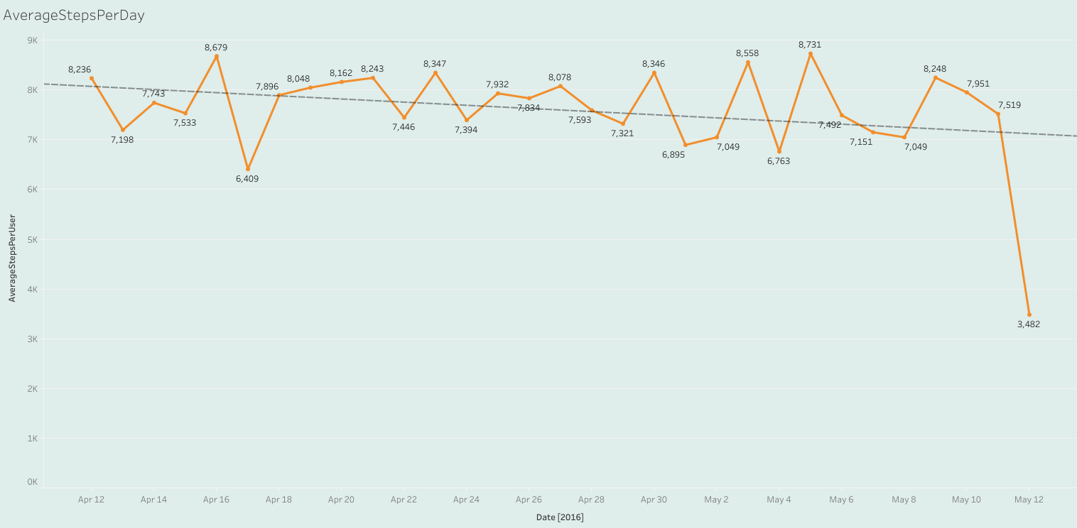
Key Findings #4
A correlation was found between time and average steps per user

Slide 9
Recommendations
End of the Month Drop in Usage
Different Usage Behaviors
User Retention
Marketing Campaigns: Challenges, Rewards, or Promos
Showcase Features and Comfortability
Loyalty Programs and Social Connectivity

Slide 10
Next Steps
Gather Data from Bellabeat
Perform Exploratory Data Analysis
Make Recommendations on new findings
Implement Recommendations

Slide 11
Conclusion
1. What are some trends in smart device usage?
Decline in Usage, Usage type variation, Positive correlation of Steps and Calories
2. How could these trends apply to Bellabeat customers?
Understanding Consumer Usage and Identify marketing opportunities and product
enhancements
3. How could these trends help influence Bellabeat marketing strategy?
Personalized messaging, targeted campaigns, and product enhancements that resonate
with consumers' preferences and behaviors, ultimately driving engagement and brand loyalty.
Notes:
The Purpose of this analysis was to answer 3 main questions,.....

Slide 12
Thank You

Slide 13
Questions & Answers

Slide 14
Resources
Original Data: Fitbit Fitness Tracker Data
Analysis Code:
Portfolio: Github
Tableau Visualization: Tableau

